Slide 1
Managing Software Quality
Main issues:
Quality cannot be added as an afterthought
To measure is to know
Product quality vs process quality
©2008 John Wiley & Sons Ltd.
www.wileyeurope.com/college/van vliet
Notes:
© SE, Quality, Hans van Vliet

Slide 2

Commitment to quality pays off
©2008 John Wiley & Sons Ltd.
www.wileyeurope.com/college/van vliet
Notes:
© SE, Quality, Hans van Vliet

Slide 3
Approaches to quality
Quality of the product versus quality of the process
Check whether (product or process) conforms to certain norms
Improve quality by improving the product or process
©2008 John Wiley & Sons Ltd.
www.wileyeurope.com/college/van vliet

Slide 4
Approaches to quality
Conformance
Improvement
Product
ISO 9126
‘best practices’
CMM
SPICE
Bootstap
ISO 9001
SQA
Process
©2008 John Wiley & Sons Ltd.
www.wileyeurope.com/college/van vliet

Slide 5


What is quality?
+
software
measures
©2008 John Wiley & Sons Ltd.
www.wileyeurope.com/college/van vliet

Slide 6
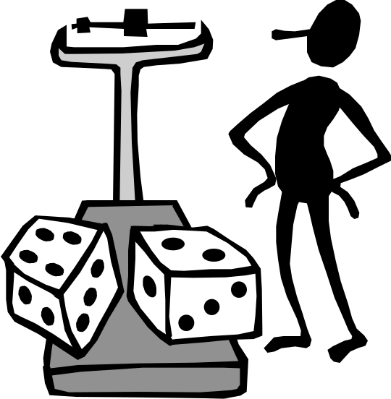
How to measure “complexity”?
The length of the program?
The number of goto’s?
The number of if-statements?
The sum of these numbers?
Yet something else?
©2008 John Wiley & Sons Ltd.
www.wileyeurope.com/college/van vliet

Slide 7
A measurement framework
Formal world
“Real” world
scale type
belongs to
unit
entity
holds for
expressed in
has
measures
value
attribute
computes
used in
part of
formalizes
attribute-relation model
attribute relation
©2008 John Wiley & Sons Ltd.
www.wileyeurope.com/college/van vliet

Slide 8

Scale types
Nominal: just classification
Ordinal: linear ordering (>)
Interval: like ordinal, but interval between values is the same (so average has a meaning)
Ratio: like interval, but there is a 0 (zero) (so A can be twice B)
Absolute: counting number of occurrences
©2008 John Wiley & Sons Ltd.
www.wileyeurope.com/college/van vliet

Slide 9
Representation condition
A measure M is valid if it satisfies the representation condition, i.e. if A>B in the real world, then M(A)>M(B)
E.g. if we measure complexity as the number of if-statements, then:
  Two programs with the same number of if-statements are equally complex
  If program A has more if-statements than program B, then A is more complex than B
©2008 John Wiley & Sons Ltd.
www.wileyeurope.com/college/van vliet

Slide 10
More on measures
Direct versus indirect measures
Internal versus external attributes
  External attributes can only be measured indirectly
  Most quality attributes are external
Scale type of a combined measure is the ‘weakest’ of the scale types of its constituents
  This is often violated; see cost estimation models
©2008 John Wiley & Sons Ltd.
www.wileyeurope.com/college/van vliet

Slide 11
Quality attributes (McCall)
Product operation
  Correctness does it do what I want?
  Reliability does it do it accurately all of the time?
  Efficiency will it run on my hardware as well as it can?
  Integrity is it secure?
  Usability can I use it?
Product revision
  Maintainability can I fix it?
  Testability can I test it?
  Flexibility can I change it?
Product transition
  Portability will I be able to use it on another machine?
  Reusability will I be able to reuse some of the software?
  Interoperability will I be able to interface it with another system?
©2008 John Wiley & Sons Ltd.
www.wileyeurope.com/college/van vliet

Slide 12
Taxonomy of quality attributes (ISO 9126)
Functionality
Reliability
Usability
Efficiency
Maintainability
Portability
©2008 John Wiley & Sons Ltd.
www.wileyeurope.com/college/van vliet

Slide 13
ISO 9126 (cnt’d)
ISO 9126 measures ‘quality in use’: the extent to which users can achieve their goal
Quality in use is modeled in four characteristics:
  Effectiveness
  Productivity
  Safety
  Satisfaction
©2008 John Wiley & Sons Ltd.
www.wileyeurope.com/college/van vliet

Slide 14

Perspectives on quality
Transcendent (“I really like this program”)
User-based (“fitness for use”)
Product-based (based on attributes of the software)
Manufacturing-based (conformance to specs)
Value-based (balancing time and cost vs profits)
©2008 John Wiley & Sons Ltd.
www.wileyeurope.com/college/van vliet

Slide 15
ISO 9001
Model for quality assurance in design, development, production, installation and servicing
Basic premise: confidence in product conformance can be obtained by adequate demonstration of supplier’s capabilities in processes (design, development, …)
ISO registration by an officially accredited body, re-registration every three years
©2008 John Wiley & Sons Ltd.
www.wileyeurope.com/college/van vliet

Slide 16

Capability Maturity Model (CMM)
Initial level: software development is ad-hoc
Repeatable level: basic processes are in place
Defined level: there are standard processes
Quantitatively managed level: data is gatheread and analyzed routinely
Optimizing level: stable base, data is gathered to improve the process
©2008 John Wiley & Sons Ltd.
www.wileyeurope.com/college/van vliet

Slide 17
Initial ⇒ repeatable level
Requirements management
Project planning
Project monitoring and control
Supplier agreement management
Measurement and analysis
Process and product quality assurance
Configuration management
©2008 John Wiley & Sons Ltd.
www.wileyeurope.com/college/van vliet

Slide 18
Repeatable ⇒ defined level
Requirements development
Technical solution
Product integration
Verification
Validation
Organization process focus
Organization process definition
Organizational training
Integrated project management
Risk management
Decision analysis and resolution
©2008 John Wiley & Sons Ltd.
www.wileyeurope.com/college/van vliet

Slide 19

CMM: critical notes
Most appropriate for big companies
Pure CMM approach may stifle creativity
Crude 5-point scale (now: CMMI)
©2008 John Wiley & Sons Ltd.
www.wileyeurope.com/college/van vliet

Slide 20
Get started on Software Process Improvement (SPI)
Formulate hypotheses
Carefully select metrics
Collect data
Interpret data
Initiate improvement actions
Iterate
©2008 John Wiley & Sons Ltd.
www.wileyeurope.com/college/van vliet

Slide 21

Lessons w.r.t. data collection
Closed loop principle: result of data analysis must be useful to supplier of data
Do not use data collected for other purposes
Focus on continuous improvement
Only collect data you really need
©2008 John Wiley & Sons Ltd.
www.wileyeurope.com/college/van vliet

Slide 22

Summary
Product quality versus process quality
Quality conformance versus quality improvement
Quality has to be actively pursued
There are different notions of quality
Quality has many aspects
Quality is hard to measure
©2008 John Wiley & Sons Ltd.
www.wileyeurope.com/college/van vliet

